Slide 1



News App
Team Members:
Name: Superset id:
1.Vishal Tiwari 1149148
2.Soumyajit Bose 1672630
3.Kottu Abhishek Venkata sai 1197715

Slide 2
Outline
Problem Statement
Objective
Technology and Tools Used
Microservices
Project Overview
Backend service structure
Onboarding-Architecture
Project Flow
Conclusion

Slide 3
Problem Statement
User wants to check the news from news app. User can be able to register themselves in the application, get the news updates and add news to favorites .

Slide 4

Objective
Our objective is to provide best user Interface and user experience.
User can be able to Register, login & logout.
User can see Top/Recommended news updates.
User can add/delete News to/from favorites in his/her account.
User can Search news using keyword.

Slide 5









Technologies and Tools Used

Slide 6
Microservices
User Authentication API
Favorite Service API

Slide 7
Project Overview
Login
Top
News List
Authentication API
Favorite API
Home
Favourites List
Search
Register
External API
MySQL
Server
MySQL
Server

Slide 8
Onboarding Architecture
Authentication API
JWT validator
MySQL Server
Login/Register
POST request
Token generated
Top News API
Get Top News
GET
NewsApi.org
Front End
Angular
Favorite News
Get Favorite News
Post Favorite News
Delete Favorite News
POST /GET/
DELETE
MySQL Server
POST /GET/
DELETE
GET
Search News
GET
NewsApi.org

Slide 9
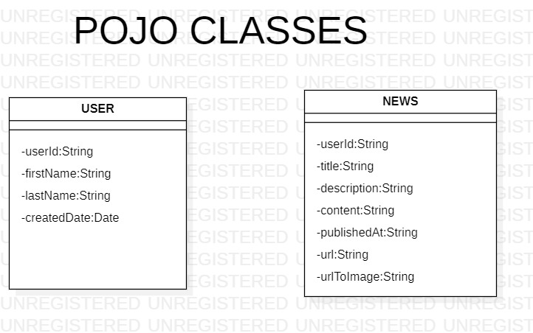
-password: string

Slide 10
Controller Layer:
User-auth-service-
@RequestMapping(path = "/api/v1/userservice ")
@PostMapping("/login") → login using user id and password
@PostMapping("/register") → Register using details
Favourite service-
@RequestMapping(path = "/api/news")
@PostMapping - saving news to favourite
@getMapping - fetching news from favourite list
@deletingMapping ("/{id}") – deleting news by id.

Slide 11
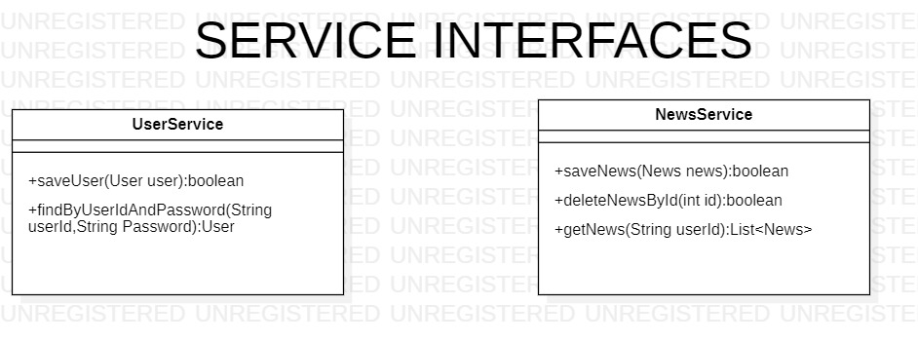

Slide 12
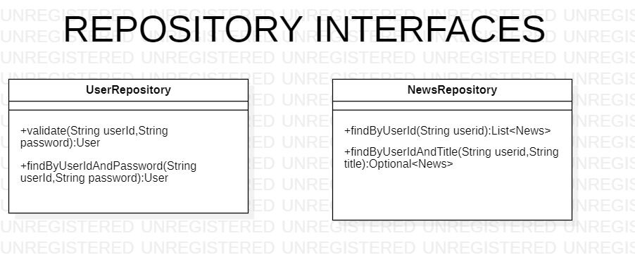

Slide 13
Frontend Services:
Services
User-auth
services
App-news
services

Slide 14
Frontend Overview
Login
component
User-auth
Register component
Frontend
module
Top-news component
Thumbnail component
App-news
Search
component
Contain component
Fav component

Slide 15
Frontend Style:
CSS
Frontend Design:
Angular Material

Slide 16
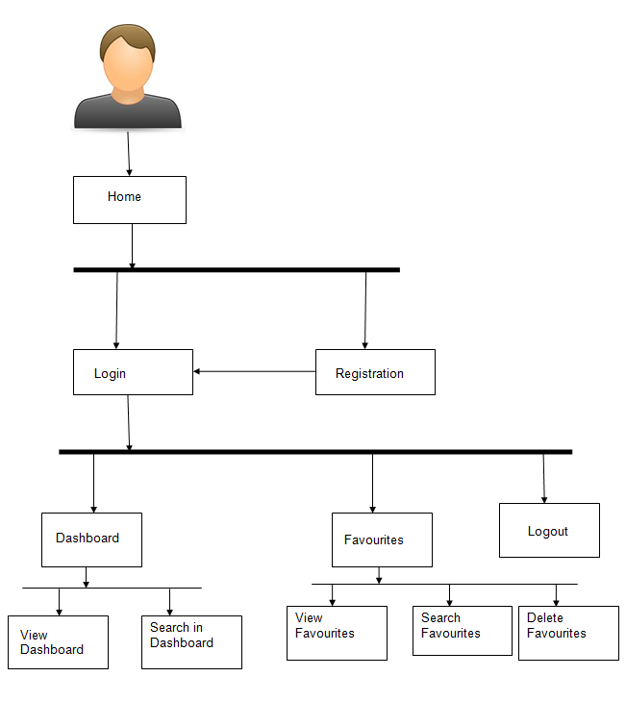
Project Flow
Home
Login
Register
Top News
Favorites
Search News
Recommends
Add to Favorites
View favorites
Delete favorites
Search Books

Slide 17
Conclusion
News app helps the users to know the various news updates.It also helps user to add/remove certain news into favorites list. User can search news using Keyword.

Slide 18
Thank You

